Slide 1
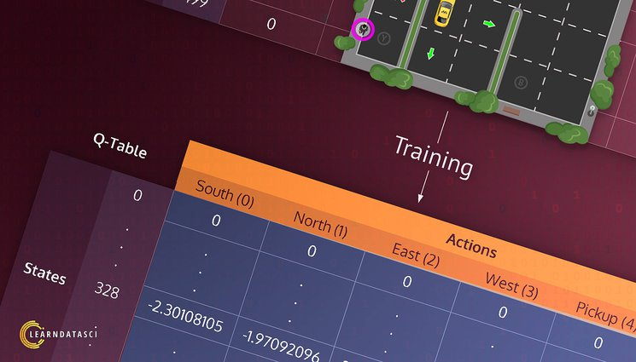
Team Members:
Shrestha Bhandari.
Adithya Sai Reddy Tamatam.

Slide 2
Project Title
Reinforcement Learning In Game.
Teach a Taxi to pick up and drop using Q Learning.

Slide 3
Statement of project objectives
Implementation of Q-Learning Algorithm: Develop and implement the Q-learning algorithm to train an AI agent.
Agent Training: Train the agent over multiple episodes, allowing it to explore and learn from the environment.
Optimal Policy Determination: Enable the agent to learn an optimal policy for passenger pickup and drop-off, maximizing its total reward

Slide 4
Approach
Understanding Reinforcement Learning Concepts.
Defining Rewards, States, and Actions:
Establish the reward system (positive and negative rewards) for the agent's actions in the environment.
Q-Learning Algorithm:
Implement the Q-learning algorithm in Python.And Train the agent using the Q-learning algorithm over multiple episodes to update Q-values.

Slide 5
Deliverables
Python Codebase: a clean and functional Python codebase that incorporates the Q-learning algorithm.
Video Presentation: detailed video demonstrating of the process, code structure, and the rationale behind design decisions.
Trained AI Agent: Produce a trained agent capable of successfully navigating the taxi environment to efficiently pick up and drop off passengers.

Slide 6
Evaluation Methodology
The agent's performance comparison before and after implementing Q-learning.
Drop off the passenger to the right location.
Save passenger's time by taking minimum time possible to drop off at their destinations.

Slide 7
Thank you…

